Slide 1

Causes of wastage in making food
Sachin Rajbhar
Ashish Kumar Pathak
Harsh Kumar
Nitish Tiwari
EVS Activity 3

Slide 2
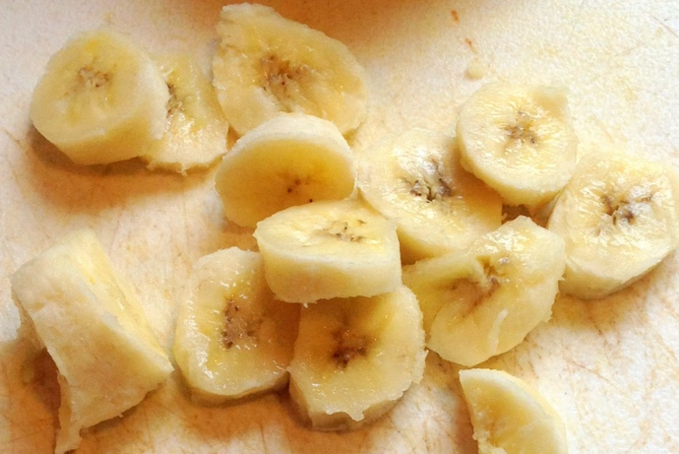
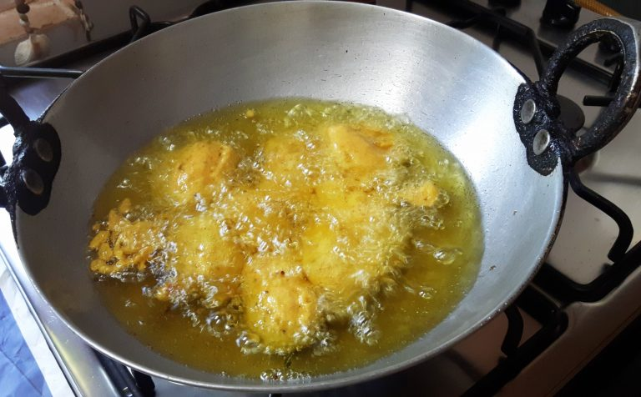
TOPIC: Banana Curry
Ingredients:-
Raw Banana
Spices
*coriander powder
*chilli powder
*turmeric powder
3) Salt, onion, tomato, garlic, oil, potato
Equipment:-
Solar Stove
Solar Cooker
Mixer/Grinder
Pan

Slide 3
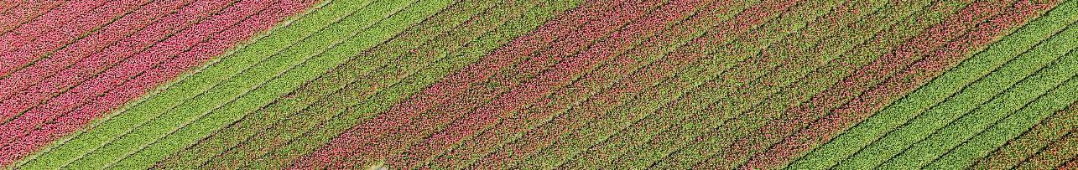
Recipe
Make onion-ginger-garlic paste
Add the fried veggies and water
Now, add the fried vegetables to it and mix. Add in 2-3 cups of water and salt to taste and allow it to boil for 5-10 minutes. When the gravy reaches the consistency you prefer then switch off the stove.
Peel the skin of raw banana and potato and cut them into strips of one inch.
Fry banana and potato
Heat the remaining oil in the same pan and add mustard & cumin seeds. Then, add in the ground paste and saute till raw smell goes. Then add in dry masala powders (red chilli powder and turmeric), tomato and saute for a while.
Add ground paste and dry masalas
Now, heat 2 tbsp of oil in a pan and fry the potato and raw banana for 3-5 minutes.
Skin the banana and potato and cut into strips
Add chopped onion, ginger, garlic to a mixer and grind it to a fine paste.

Slide 4
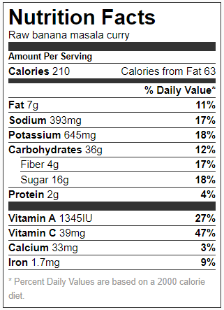

Slide 5
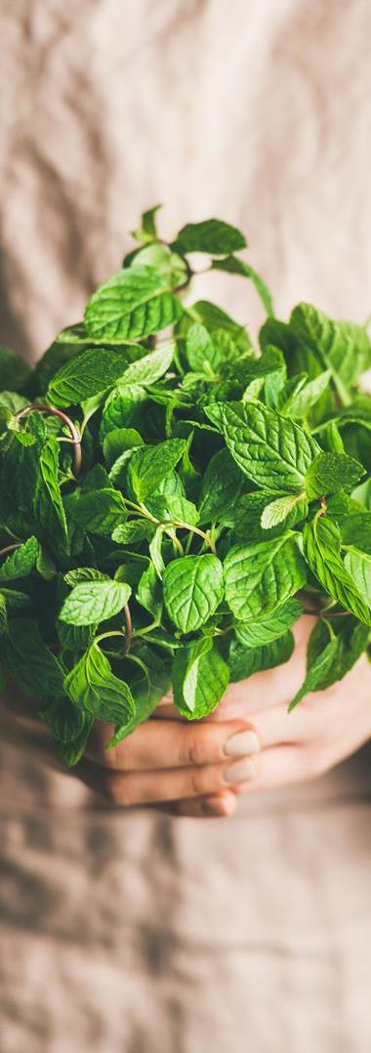
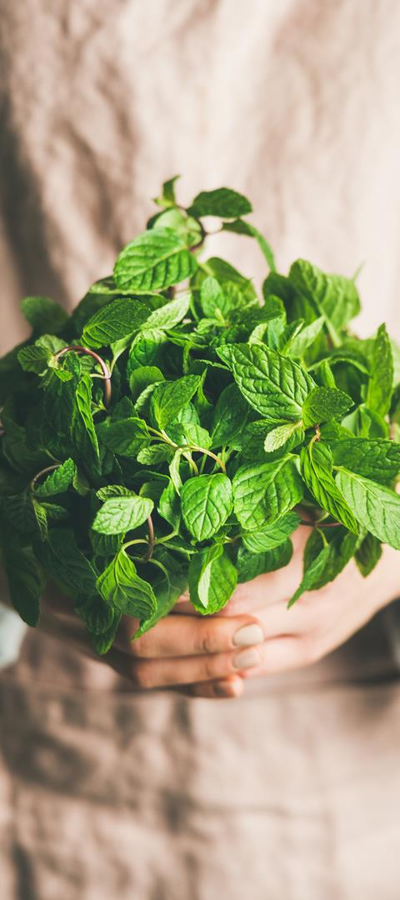
Wastages in Preparing Curry
 | Approx. Amount (in grams)
Banana Peel | 50
Onion Peel | 3.2
Garlic Peel | 5

Slide 6
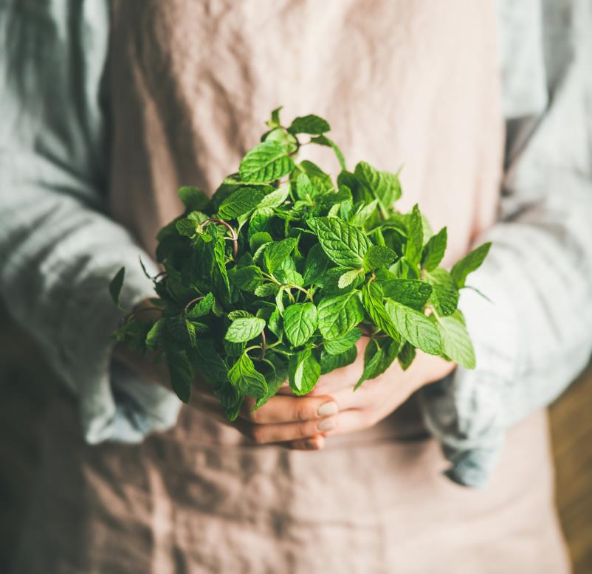
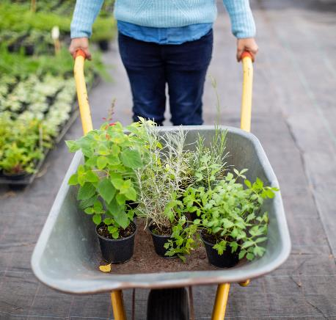
Use of Wastages
Can be used as compost to enrich soil organic content.
As Animal Food such as, for cows, buffalos etc.

Slide 7
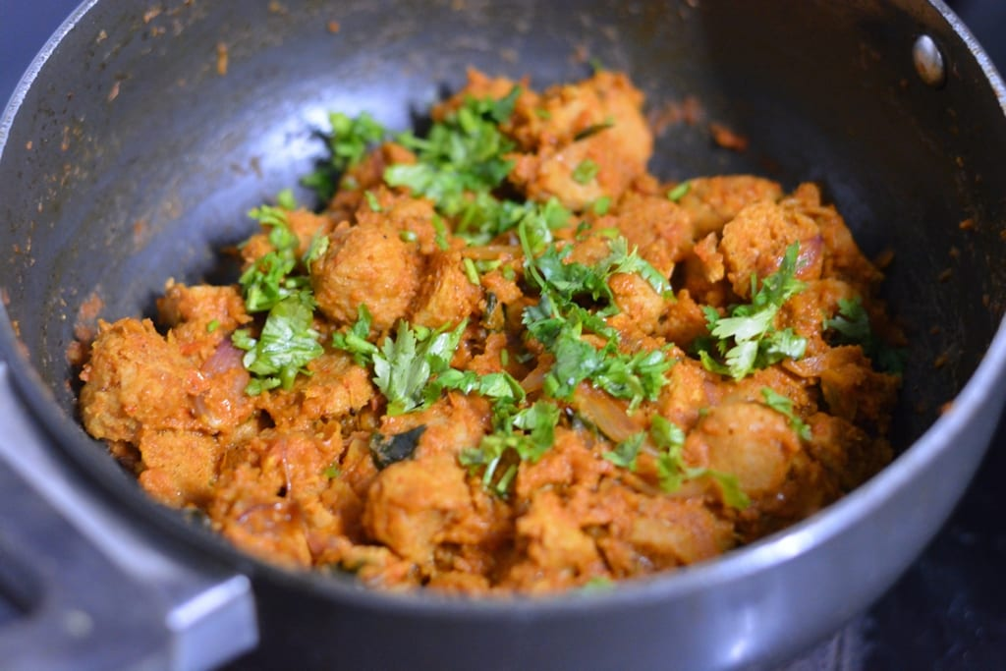
Curry Khaalo!!😋 Thank You
This Photo by Unknown Author is licensed under CC BY-NC-ND

